Slide 1

Microsoft Word 2007 – Level 1
Chapter 5
APPLYING FORMATTING & INSERTING OBJECTS

Slide 2

Performance Objectives
Insert section breaks
Create and format text in columns
Hyphenate words automatically and manually
Create a drop cap
Insert symbols, special characters, and the date and time
Use the Click and Type feature
Vertically align text
Insert, format, and customize pictures, clip art images, text boxes, shapes, and WordArt

Slide 3
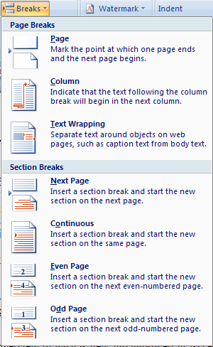
Inserting a Section Break
To format each section separately
Position insertion point, click Page Layout tab, click Breaks
click desired
option

Slide 4
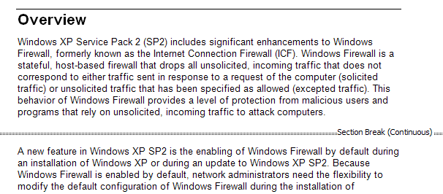
Removing a Section Break
Must be in Draft View
Position insertion point on Section Break dotted line
then press the DEL key

Slide 5
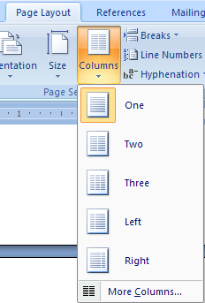
Creating Columns
Select text first
click to select
desired number of columns
Page Layout tab,
Columns
Change to Print Layout View to see how columns will appear when printed

Slide 6
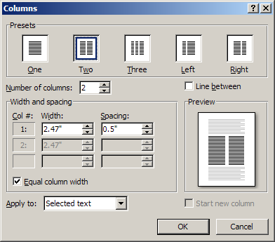
Creating Columns…/2
Columns Dialog Box
Page Layout, Columns,
More Columns
click an option or
type the number
of desired columns
click to add a line
between columns
default spacing
between columns
apply to
Whole document
or
This point forward or
selected text / sections
remove checkmark to enter
your own column widths

Slide 7
Inserting a Column Break
Position insertion point first
Press
Ctrl + Shift + Enter
OR
Page Layout tab, Breaks, Column

Slide 8
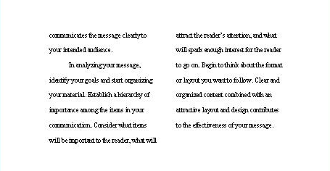
Balancing Columns on a Page
Position insertion point at the end of the last column to be balanced
Page Layout tab, Breaks, Continuous
balanced
columns
click

Slide 9
Removing Column Formatting
Position insertion point,
click Page Layout tab, Columns
click ‘One’

Slide 10
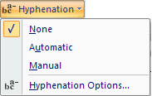
Hyphenating Words
Page Layout tab, Hyphenation
click
Automatic -
Word places hyphens to reduce jagged edge
Manual -
Word presents each possibility for acceptance

Slide 11
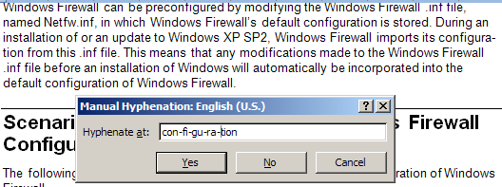
Manually Hyphenate Words
Page Layout tab, Hyphenation
click

Slide 12
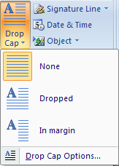
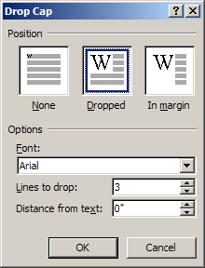
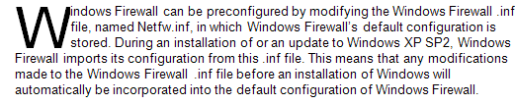
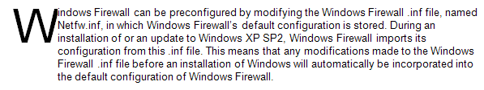
Creating a Drop Cap
Insert tab, Drop Cap
click
Sample
To set Font, size, and distance from text

Slide 13
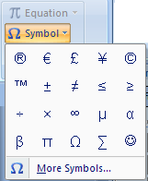
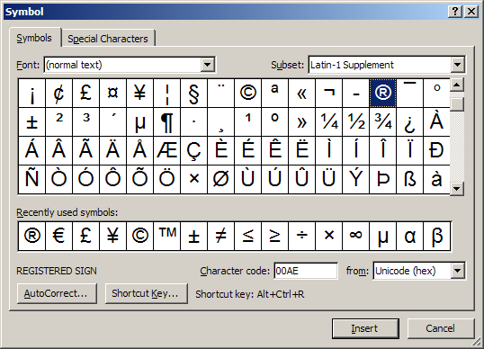
Inserting Symbols & Special Characters
Insert tab, Symbol
click a symbol in list
or, click More Symbols
Double-click desired symbol

Slide 14

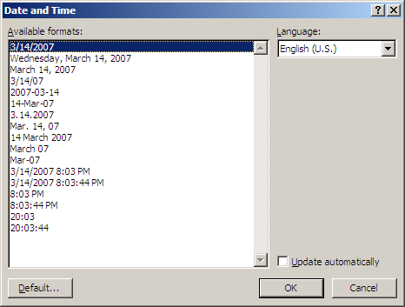
Inserting the Date and Time
Insert tab, Date & Time
click
select a format
and click OK
check to insert a field that is updated each time the document is opened

Slide 15
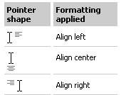
Using the Click and Type Feature
In Print Layout View, hover mouse between
left and right margins
pointer
shapes
based on position between margins
Double-click in desired location

Slide 16
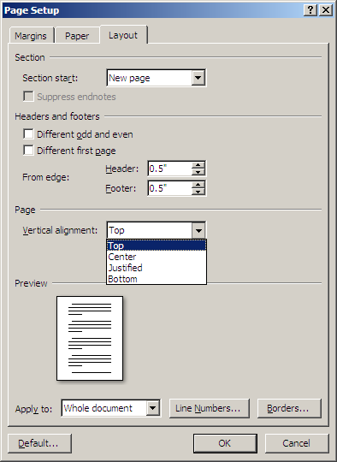
Vertically Aligning Text
Page Layout tab, Page Setup button
Layout tab
alignment options

Slide 17

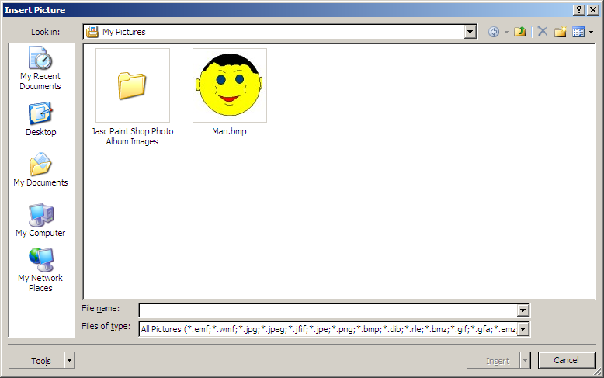
Inserting Images in a Document
Insert tab, Picture
After inserting picture (or Clip Art), Picture Tools Format bar appears
Insert Picture dialog box appears

Slide 18
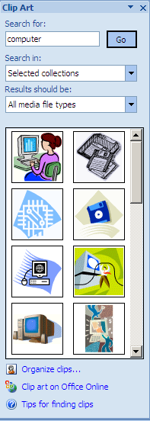

Inserting ClipArt
Insert tab,
Clip Art
Clip Art
Task Pane

Slide 19
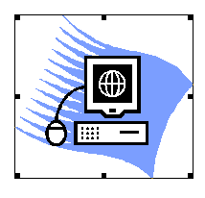
Sizing an Image
Click image to show handles
(mouse pointer changes
when over handle)
↕
↕
↕
↕
Drag sizing handle to resize image
(corner resize maintains image proportion)
When sizing an image, consider using the rulers

Slide 20




Formatting Images with the Picture Toolbar
PICTURE TOOLBAR GROUPS
Adjust image qualities
Change image style and effects
Image placement on page
Crop, Resize

Slide 21
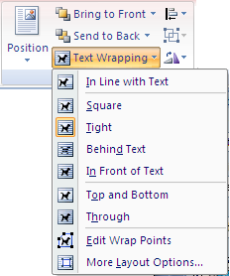
Moving an Image
To move an image you must first choose a text wrapping option
Click Text Wrapping
button in Arrange group and click
an option
Drag image to desired position when mouse pointer placed on image border turns into a four-headed arrow

Slide 22

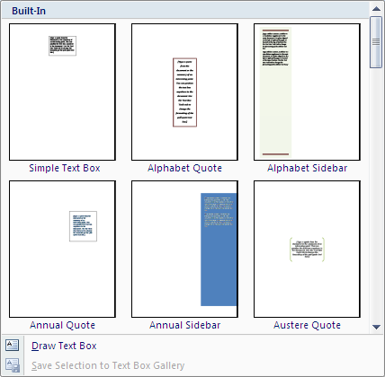
Creating a Pull Quote
Insert tab,
Text Box
click desired pull quote

Slide 23





Using the Text Box Toolbar
TEXT BOX TOOLS FORMAT GROUPS
Text
Change text colors and shape
Text Box Look
Text Box placement on page
Resize

Slide 24

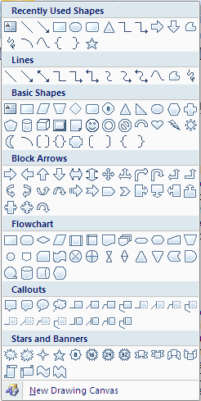
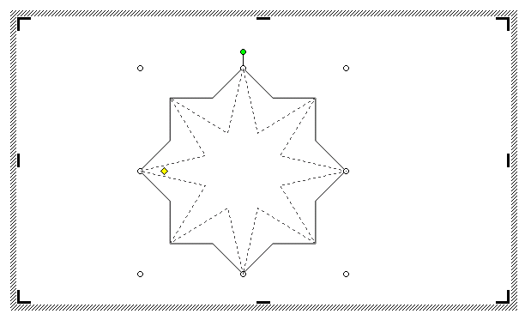
Drawing Shapes
Insert tab,
Shapes
click desired shape,
then
drag and draw
some shapes
contain an
adjustment
handle

Slide 25


Copying Shapes
Or, click and drag shape to desired location while holding Ctrl key
select shape
click Copy button
(in Home tab)
position insertion point
click Paste button
(in Home tab)

Slide 26
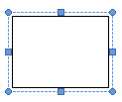
Drawing & Formatting a Text Box
Insert tab,
Text Box
then
drag and draw
click
can type or Insert objects here

Slide 27
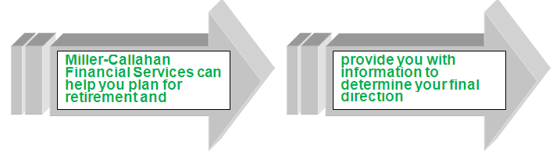
Linking Text Boxes
Text Box Tools Format tab,
Create Link
Draw text boxes first, then select the first text box in link,
click
then click the next text box
(typed text wraps to next text box)

Slide 28

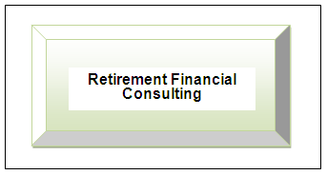

Selecting Objects
Home tab,
Select button
click
draw box around objects

Slide 29

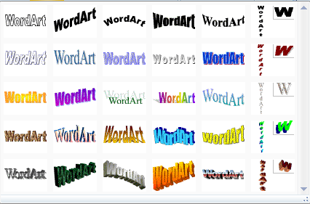
Inserting WordArt
Insert tab,
WordArt
used to distort or reshape text
click
choose
Change text wrap after WordArt appears

Slide 30
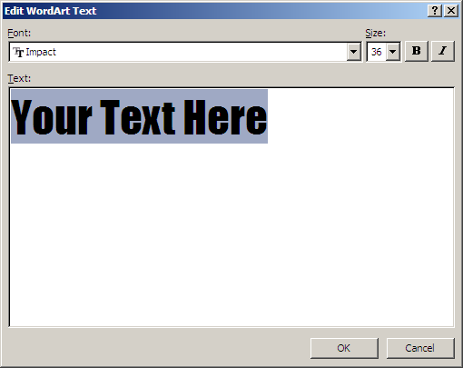
Inserting WordArt …/2
type text
choose Font, font size
click OK
Change text wrap after WordArt appears

Slide 31
Features Summary
How do you display the Columns dialog box?
Page Layout tab,
Columns,
More Columns

Slide 32
Features Summary
How do you insert a column break?
Press Ctrl + Shift + Enter
OR
Page Layout tab, Breaks, Column

Slide 33
Features Summary
How do you remove column formatting?
Page Layout tab,
Columns
Choose ‘One’
can also Undo
if done immediately

Slide 34
Features Summary
How do you hyphenate long words on the right margin?
Page Layout tab, Hyphenation
click

Slide 35
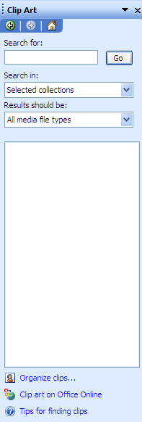
Features Summary
How do you display the Clip Art task pane?
Insert tab,
ClipArt
Clip Art
Task Pane

Slide 36
Features Summary
How do you display the Picture Tools Format ribbon?
Click on an image
OR
Insert tab, Picture,
find and insert a picture

Slide 37
Features Summary
How do you resize an image?
Click image to show handles
(mouse pointer changes
when over handle)
↕
↕
↕
↕
Drag sizing handle to resize image

Slide 38
Features Summary
How do you move an image?
Click and drag to desired position
OR
Select the image
click Cut button
position to desired location
click the Paste button

Slide 39
Features Summary
How do you insert a copyright symbol?
Insert tab, Symbol
click
click on desired symbol

Slide 40
Coming Next
Chapter 6
MAINTAINING DOCUMENTS

